Slide 1
Nike Products
These are the products of Nike

Slide 2
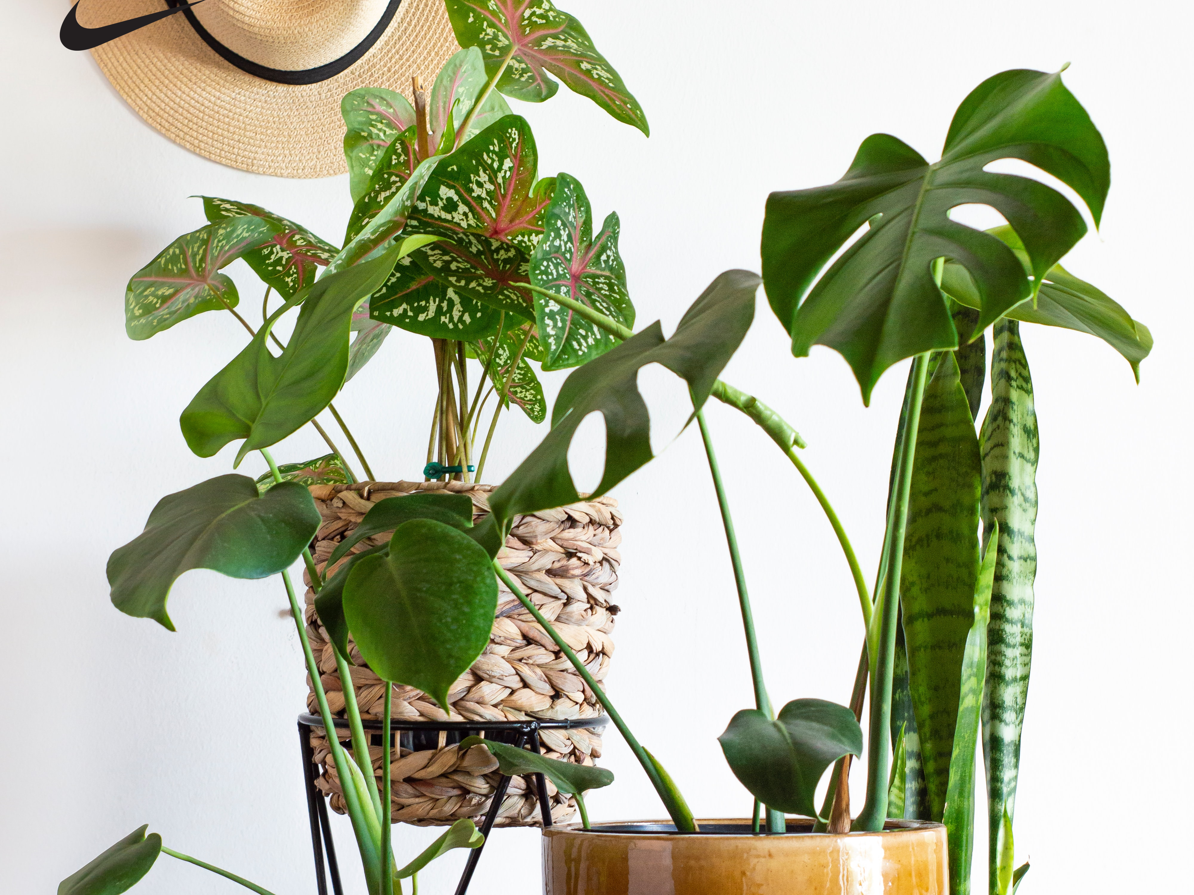
Home Garden
Plants in a house

Slide 3

Orange Juice!
Tasty!

Slide 4
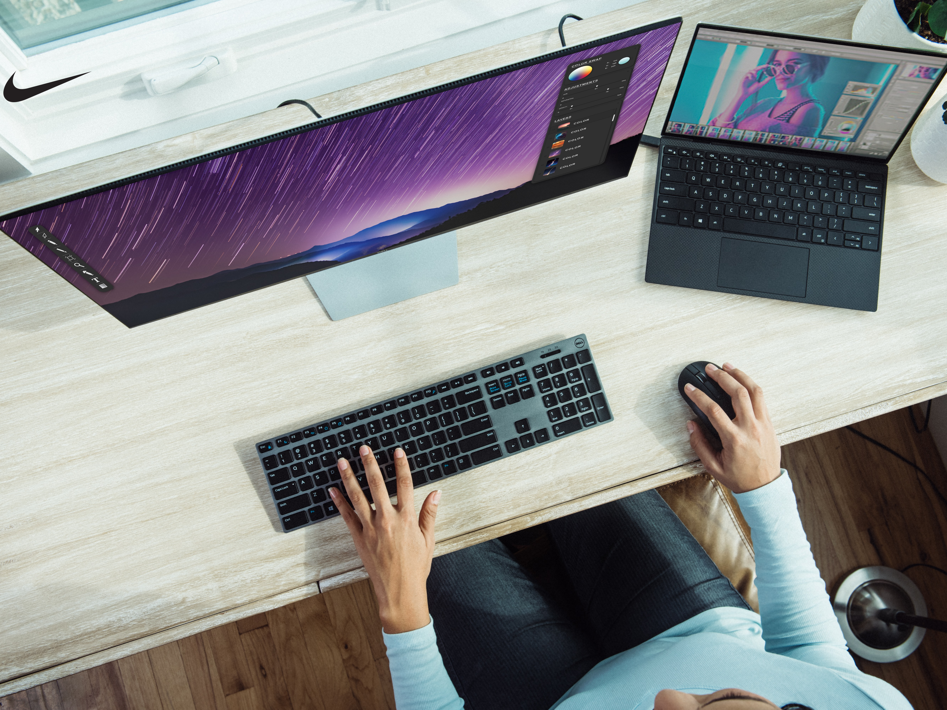
Simple Work Place
Aesthetically Awesome

Slide 5
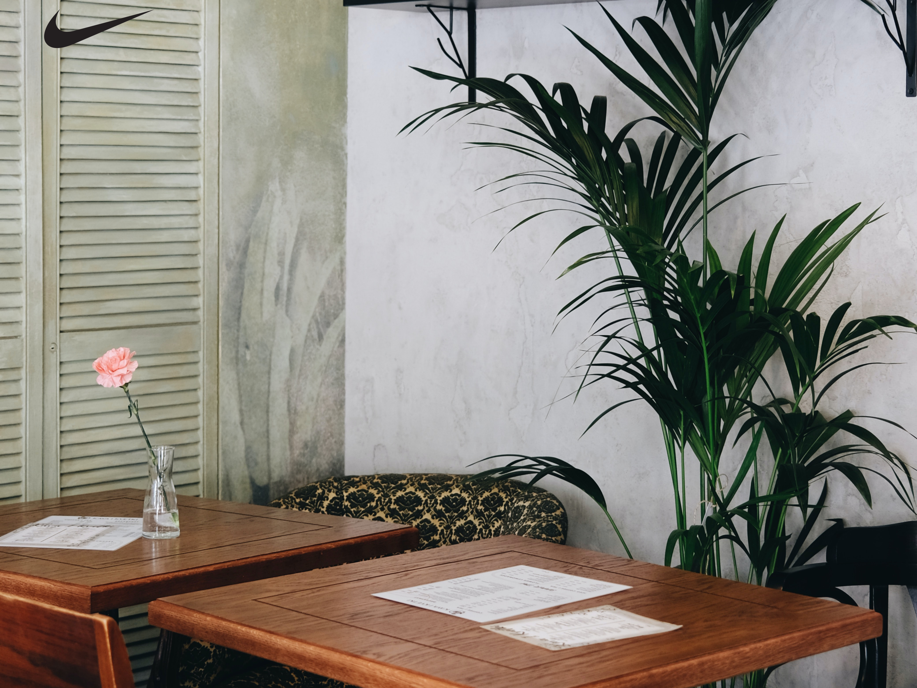
Modern Furniture
Too Expensive

Slide 6

Cameraaa!!
Analog Awesome

